Slide 1
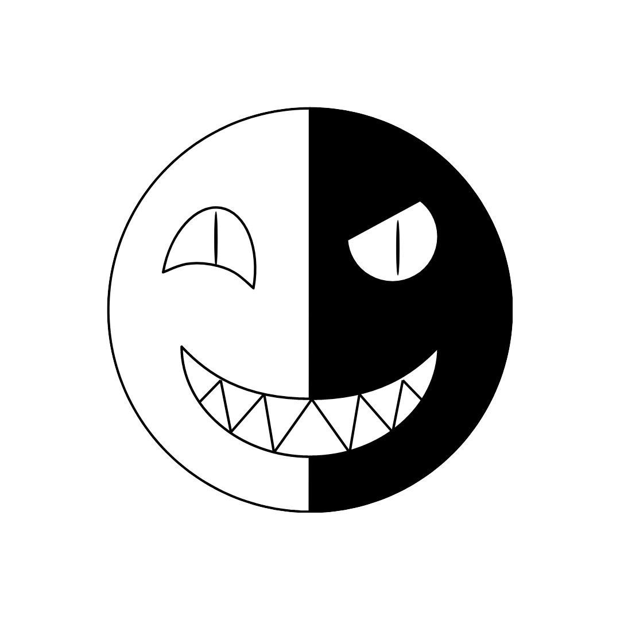
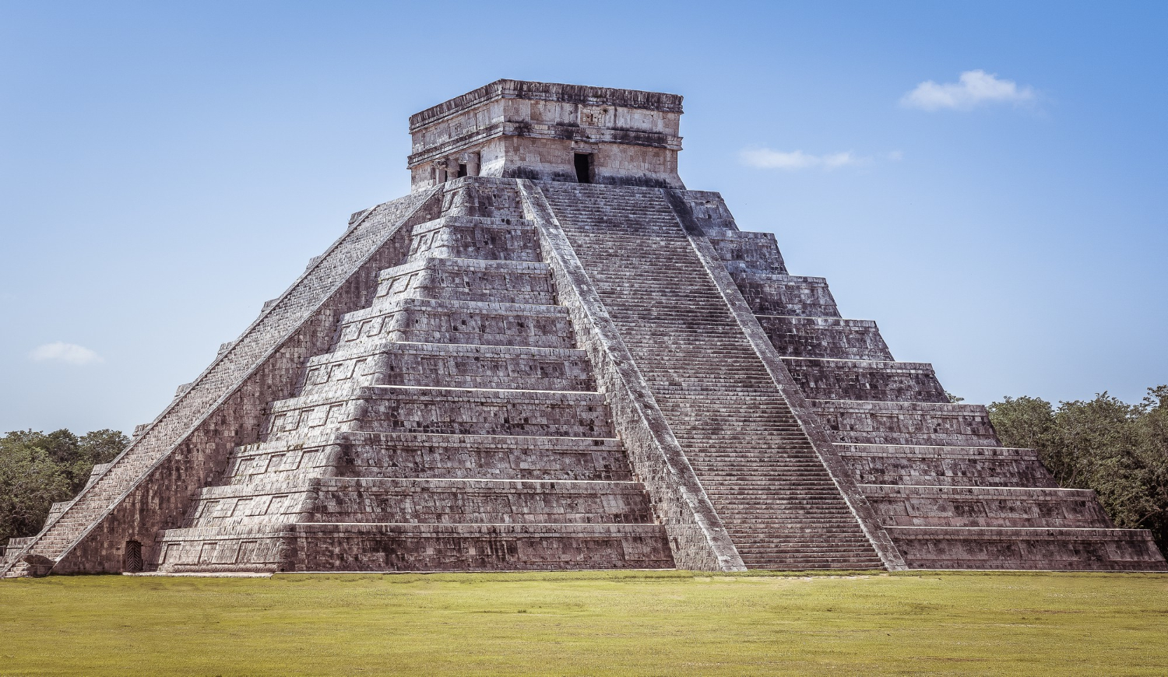
Kukulkan Chess
Adding a new special piece to the chess game
© by cheetah.studio or Edwin Keller

Slide 2
Origin and Meaning
Kukulkan, Gukumatz and Quetzalcoatl all meaning „Plumed Serpent“
The plumed serpent is descending from the Mayan pyramid „El Castillo“ during equinox (duration of daytime = nighttime).
=>So Kukulkan is a hybrid creature: half good, half evil.
How does a hybrid piece fit into a game like Chess?

Slide 3
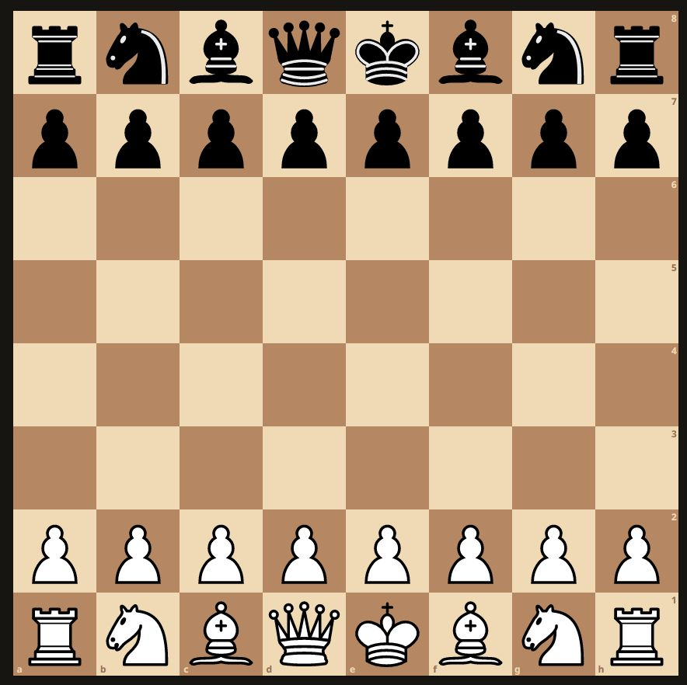
Starting point
White decides where to put Kukulkan on one of the squares of the lines 4 or 5 (green rectangle). White can set the orientation of Kukulkan as well (4 possibilities).

Slide 4
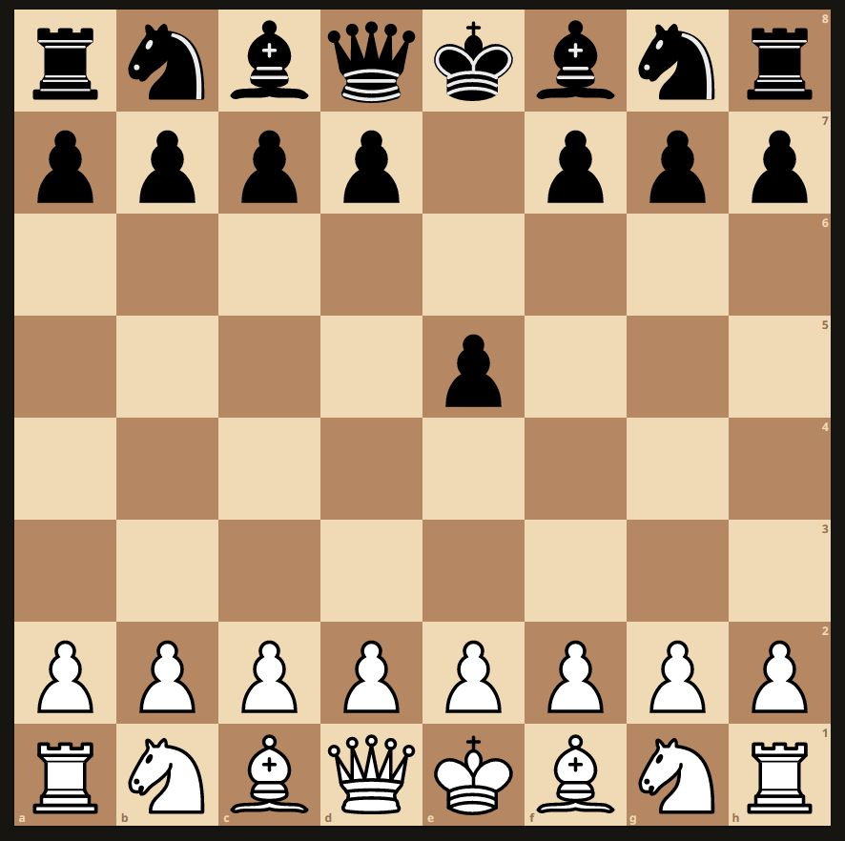
Who can steer Kukulkan?
After White has set Kukulkan, Black can make the next move. Kukulkan can’t be beaten. The party, who has the most attacks on Kukulkan, can steer him. Kukulkan can’t move, if nobody is attacking him, or the attack counters are equal.

Slide 5
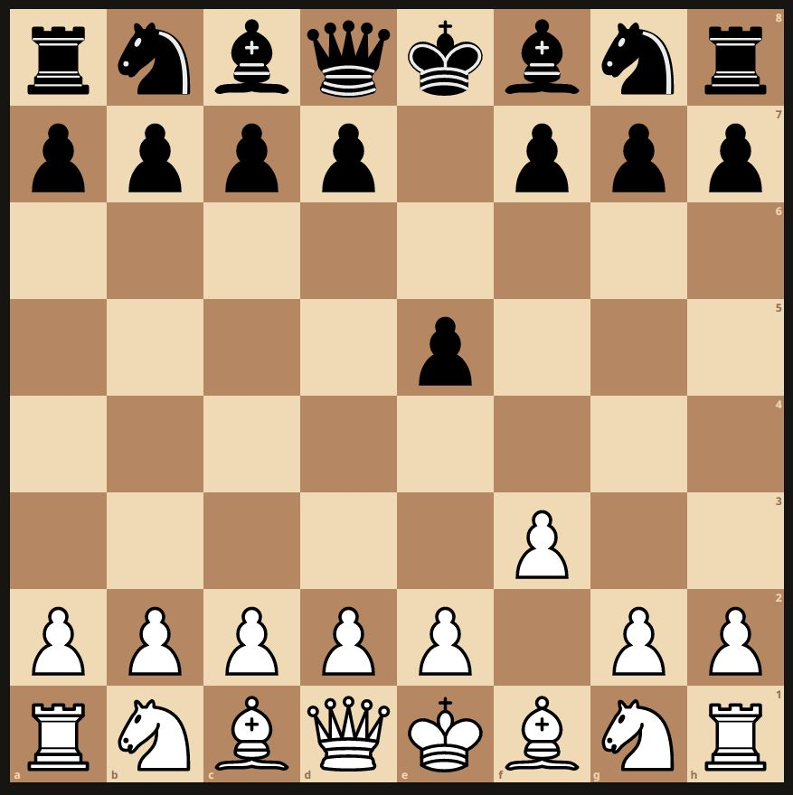
How to move and beat?
Black can steer Kukulkan. He can move and beat as far as possible in direction of the green arrows. He can only move (but not beat) as far as possible in direction of the yellow arrows. In one move he can also be rotated (3 possibilities).

Slide 6
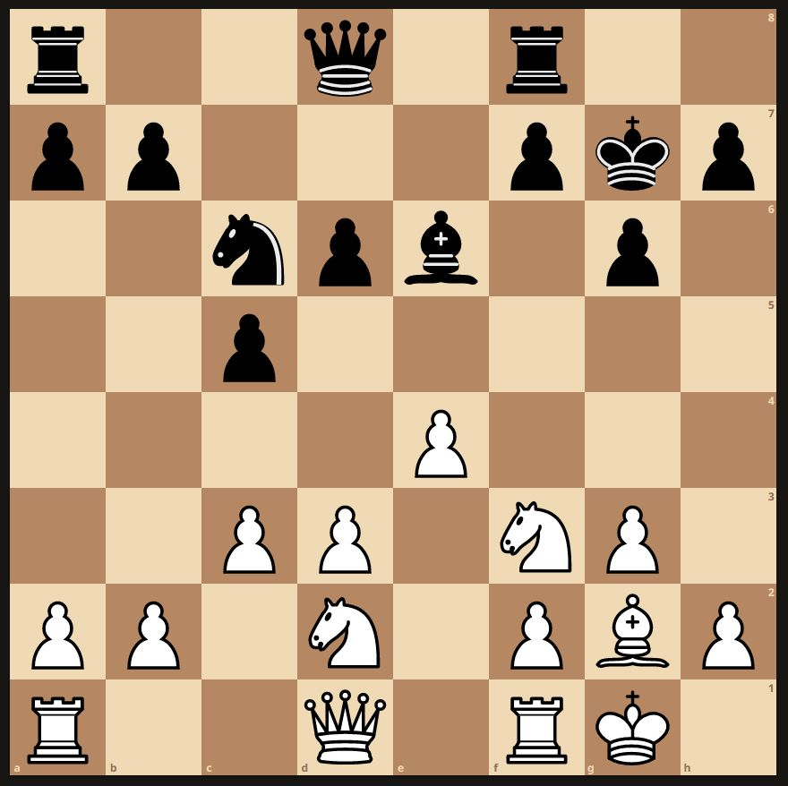
Illegal moves
It’s Black’s turn. The attack counters on Kukulkan are 2:2. Nobody can steer Kukulkan. Black can’t move the pawn on c5 and neither can the black knight on c6, because it would cause Check! They are pinned.

Slide 7
Variations
Add more than one Kukulkan to the game.
Add a rule which allows Kukulkan to beat or sacrifice the own chess pieces.

Slide 8
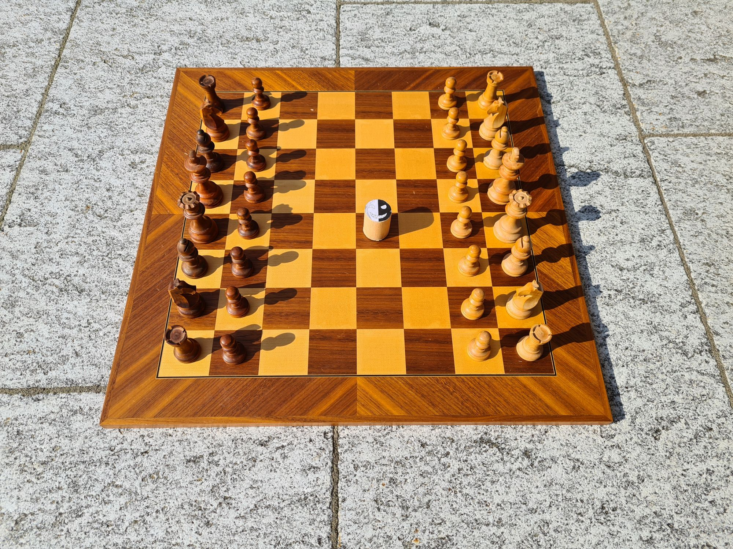
Thank You! Enjoy Kukulkan Chess!
© by cheetah.studio or Edwin Keller

